Slide 1
Lessons Learned While Deploying vSAN Two-Node Clusters
2
+
2
+
Wes Milliron – Systems Engineer
@wesmilliron
blog.wesmilliron.com

Slide 2
Overview
2
+
2
+
What vSAN is and how it works
vSAN Requirements and Design Considerations
Configuration Summary with Gotchas
Unexpected Outcomes
Resources

Slide 3
What is vSAN?
Software-defined storage solution
Pools local storage from hosts into a single shared datastore
Policy-driven (SPBM) performance and protection control
No hardware RAID

Slide 4
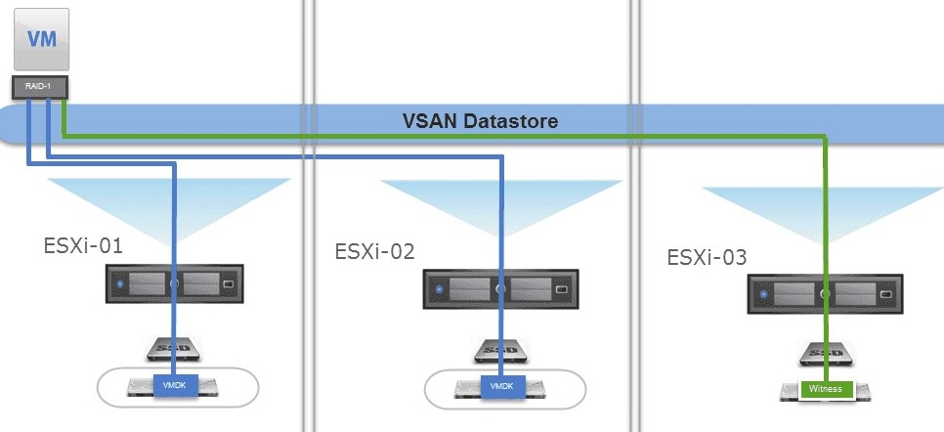
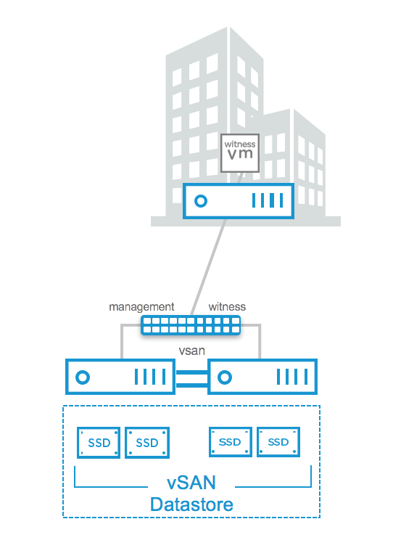
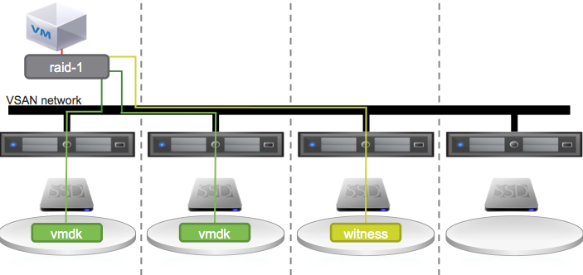
Types Of vSAN Deployments
2
+
vSAN 3-Node Cluster
Supports 1 failure
vSAN 2-Node Cluster
Supports 1 failure
vSAN 3-Node Cluster
vSAN 4+ Node Cluster
Supports 2+ failures
vSAN 4+ Node Cluster

Slide 5
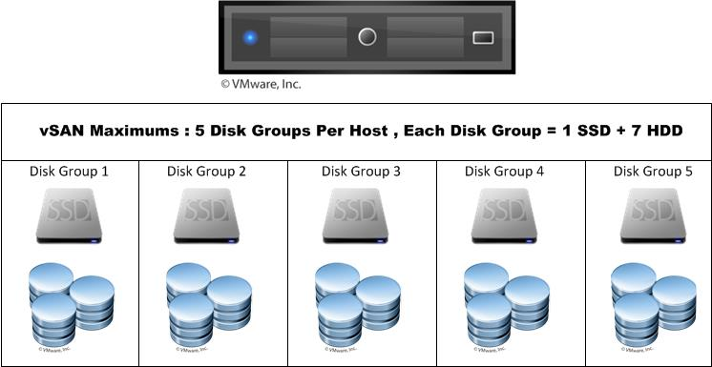
Title
Disk Groups
2
+
Example Hybrid vSAN Host
Logical grouping of physical disks on a host
Each disk group has 1 SSD for cache, and 1 or more capacity disks
At least 2 disk groups recommended per host

Slide 6
Objects and Components
vSAN is object-based distributed storage
Objects are split into components, which are distributed across the hosts in the cluster
Component count is determined by object size/policy
Failures to Tolerate (FTT)
“RAID” Type
Disk Stripes
Maximum component size of 255 GB
50% of an objects components must be available

Slide 7
Title
What is vSAN 2-Node for?
2
+
ROBO = Remote Office/Branch Office = License type
When HA is required, but the VM count for a site is low
Less expensive alternative to other HA ROBO solutions
Requires witness host

Slide 8
Requirements | Hardware Compatibility
2
+
vSAN leans heavily on hardware functionality
Use the vSAN Hardware Compatibility List (HCL) while planning
Other options:
VxRail from Dell EMC is an appliance-type solution
Certified vSAN ReadyNodes from OEM partner of choice
NEW: vSAN Hardware Compatibility Checker Fling

Slide 9
Requirements | Networking
Maximum of 500 ms latency is supported from hosting site to witness, but sub-200ms is recommended
Witness bandwidth required is 2Mbps/1000 components
Each host has a 9000 component maximum
Witness bandwidth won’t exceed 18 Mbps
2
+
 | Between Hosting Nodes
Max Latency | 1 ms RTT
Bandwidth (Hybrid) | 1 Gbps
Bandwidth (All-Flash) | 10 Gbps

Slide 10
vSphere and vSAN Versions
For vSAN versions 6.6 and later, unicast is fully supported for vSAN traffic
vSAN 6.6 Requires at least ESXi 6.5.0d
Try to avoid earlier versions
Notes:
Online health checks use vSAN telemetry data and give the added benefit of HCL checks, improved debugging, etc

Slide 11
Title
2
+
Requirements | Cluster Witness
One witness per cluster
Maintains quorum and data accessibility of the cluster
Contains witness components
Does not contribute CPU/RAM/Storage to cluster
Witness OVA exclusively for 2-node and stretched cluster vSAN

Slide 12
Licensing Considerations
vSAN License Options
Two licenses required:
One for vSphere (hosts)
One for vSAN (cluster)
ROBO licenses have a 25 VM maximum
DRS requires a vSphere Enterprise license

Slide 13
Design | Limiting Factors
2
+
2
+
Determine your limiting factors:
Budget
Site networking options
Witness location and networking
Capacity
Hardware
Networking
Notes:
Site networking options - 10 GB port availability - When would you choose to configure the cluster as direct-connect

Slide 14
Design | Capacity Planning
2
+
2
+
Determine your limiting factors
Capacity
Hybrid or all-flash configuration
2-node clusters are limited to mirrored storage policies
Storage multiplier for mirrored policies is 2X
Hardware
Networking

Slide 15
Design | Hardware Considerations
2
+
2
+
Determine your limiting factors
Capacity
Hardware
Cache drive should be at least 10% of consumed storage
Write buffer is limited to 600 GB
SAS SSD vs M2 vs SD Card
Separate RAID controller for OS volume
Networking
Notes:
Largest cache drive that makes sense
Hybrid 70/30 read/write
All cases – size should be at least 10% of total VM consumed size for cluster
Using DVS allows for easy management as well as use of NIOC
HCL is your friend

Slide 16
Design | Networking Approach
2
+
2
+
Determine your limiting factors
Capacity
Hardware
Networking
Distributed Switch vs Standard vSwitch
NIOC
Link Aggregation Groups (LAG)
vCenter Portability
Notes:
Using DVS allows for easy management as well as use of NIOC

Slide 17
Build Summary
2
+
2
+
Build ESXi hosts
Configure DVS
Deploy vSAN Witness
Create Cluster
Configure vSAN
Notes:
This is the order I found that has the smoothest deployment
High-level view of the build and configuration steps – touching on gotchas
Don’t forget to document the process

Slide 18
Host Configuration
2
+
2
+
Build ESXi hosts using standard practices
RAID controllers
Passthrough mode
Write caching disabled
Enable vMotion service on each host
Don’t forget NTP and Syslog!
Notes:
If the controller can’t do passthru, RAID 0 configuration will work

Slide 19
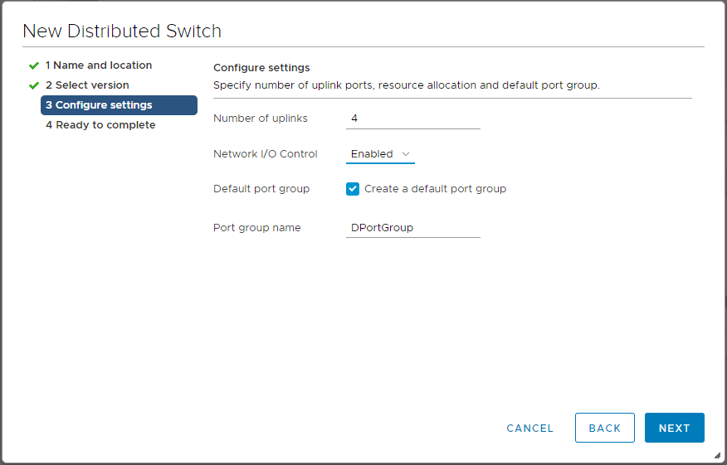
Title
Networking Configuration
2
+
Distributed vSwitch Creation
Number of uplinks
NIOC

Slide 20
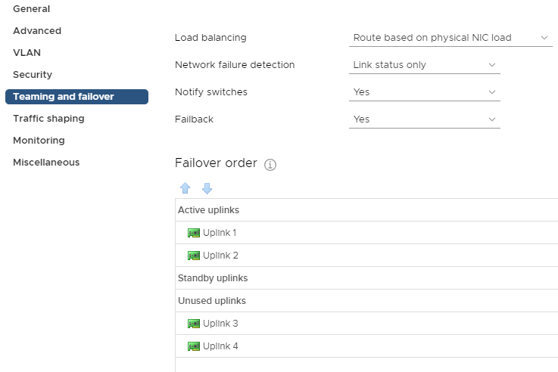
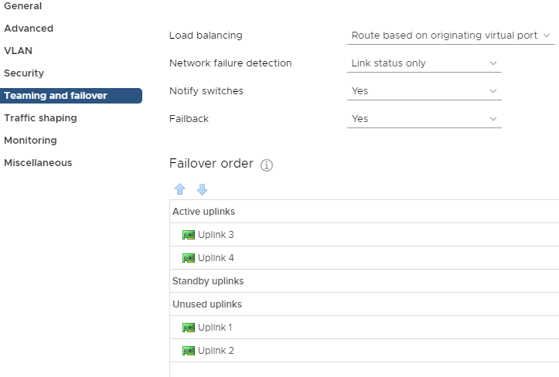
Title
Networking Configuration
2
+
vSAN Port Group
Management Port Group

Slide 21
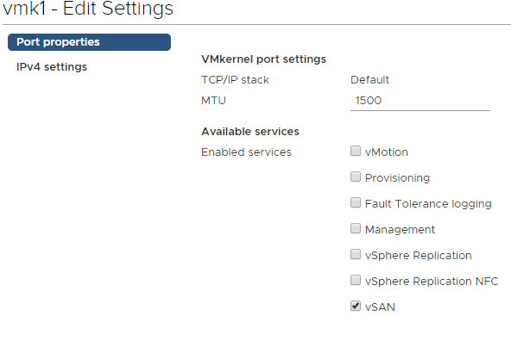
Title
Networking Configuration
2
+
vSAN VMK Creation
Dedicated for vSAN traffic
Remember the vSAN service!
Notes:
Create VMK for vSAN on each host

Slide 22
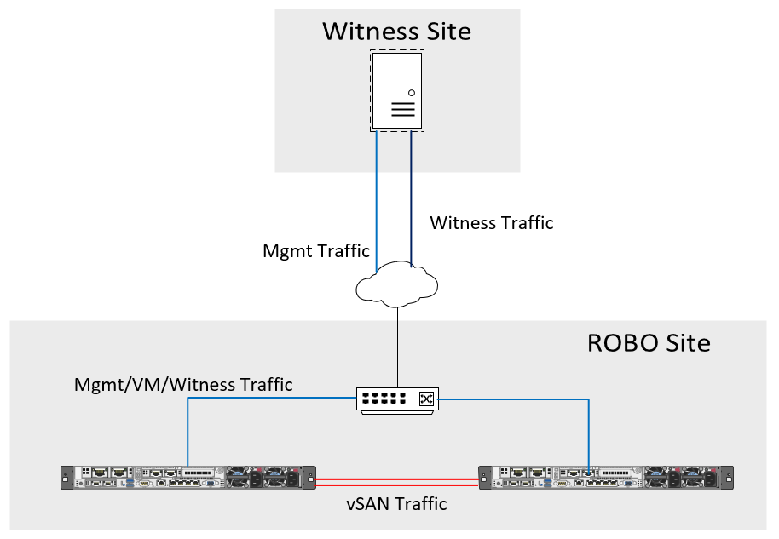
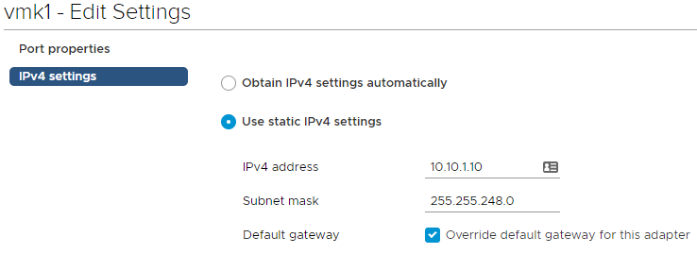
Witness Deployment
Separate subnets for management and vSAN VMKs
Set management IP, hostname, etc
Add witness host to vCenter
Modify witness vSAN VMK
Override default gateway

Slide 23
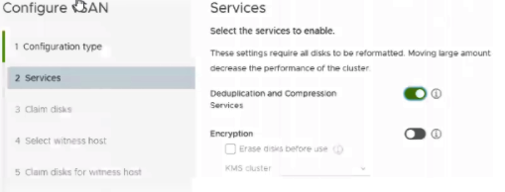
vSAN Cluster Creation
2
+
2
Create cluster object in vCenter with DRS and HA disabled
Enable vSAN service on the cluster
Enable dedupe/compression if applicable
Claim vSAN disks for cache and capacity roles
Code to link NAA ID with Drive Bay
Select the deployed witness appliance as cluster witness
+
C

Slide 24
Required Extra Step for Direct-Connect Clusters
2
+
Witness traffic must be re-routed out of the management VMK
Run from each VM host - not witness
Information on Witness Traffic Separation
Troubleshoot with vmkping
esxcli vsan network ip add -i vmk0 –T=witness
vmkping <IP of vsan VMK on target> -I vmk1
Notes:
By default, witness traffic from the hosts travels across the vsan network – in a direct connect scenario, that network is not routable. The witness traffic needs to be re-routed.
Vmk0 is the management network, in this example

Slide 25
Title
2
+
Finishing Touches
Patching
Assign license to the cluster
Enable High Availability
Admission Control set to 50% reserved for CPU and Memory
Datastore heartbeating is not enabled by default on vSAN datstores
Without DRS, VMs need to be manually migrated
Hosts and witnesses must be at the same patch level
Upgrade the vSAN on-disk format version after entire cluster is patched
Notes:
Admission control 50% reserved due to the mirrored, RAID-1, FTT=1 nature of the cluster

Slide 26
vSAN Health Check
Able to drill down into potential issues
Automatically remediate problems
Online health checks

Slide 27
Deployment Strategies
2
+
Build and Ship
Stage environment in-house
Change IPs/DNS before shutdown
Ship to remote site
Ship and Build
Deliver to remote site
Build remotely
Remote hands follow runbook

Slide 28
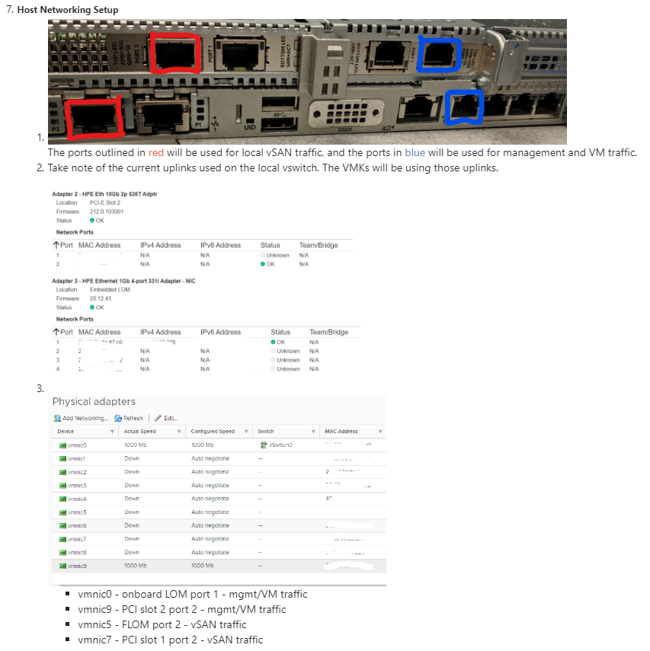
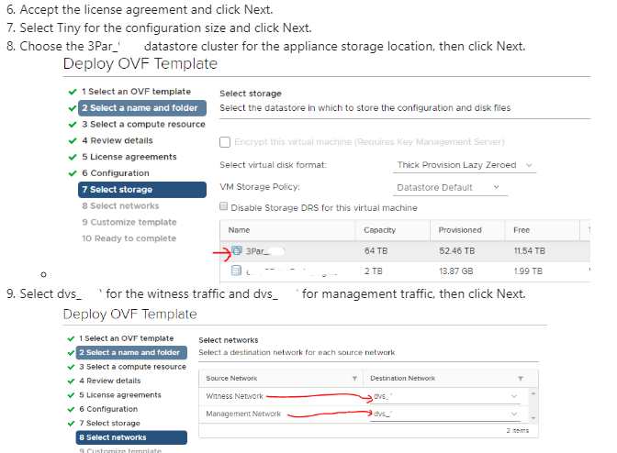
Title
2
+
Documentation

Slide 29
Title
2
+
Unexpected Outcomes
Organizational culture shift
Aligning design and deployment strategies
Do it once – do it right

Slide 30
Resources
2
+
2
+
Storage Hub - VMware
Virtual Blocks Blog
Cormac Hogan’s Blog
Wes Milliron’s Blog
Building a 2-Node Direct Connect vSAN Cluster
Associating NAA ID with Physical Drive Bay
Use the vCommunity!
Notes:
vSAN 6.7 U1 Deep Dive book
Can’t use a single blog post/source, pull info from multiple sources and community experts

Slide 31
Thank You
2
+
2
+
@wesmilliron
blog.wesmilliron.com

